Slide 1
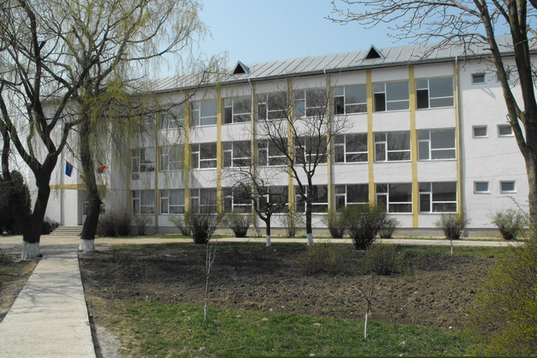
Liceul ,,Stefan D. Luchian” Stefanesti, Botosani, Romania

Slide 2
Some of our handmade things

Slide 3
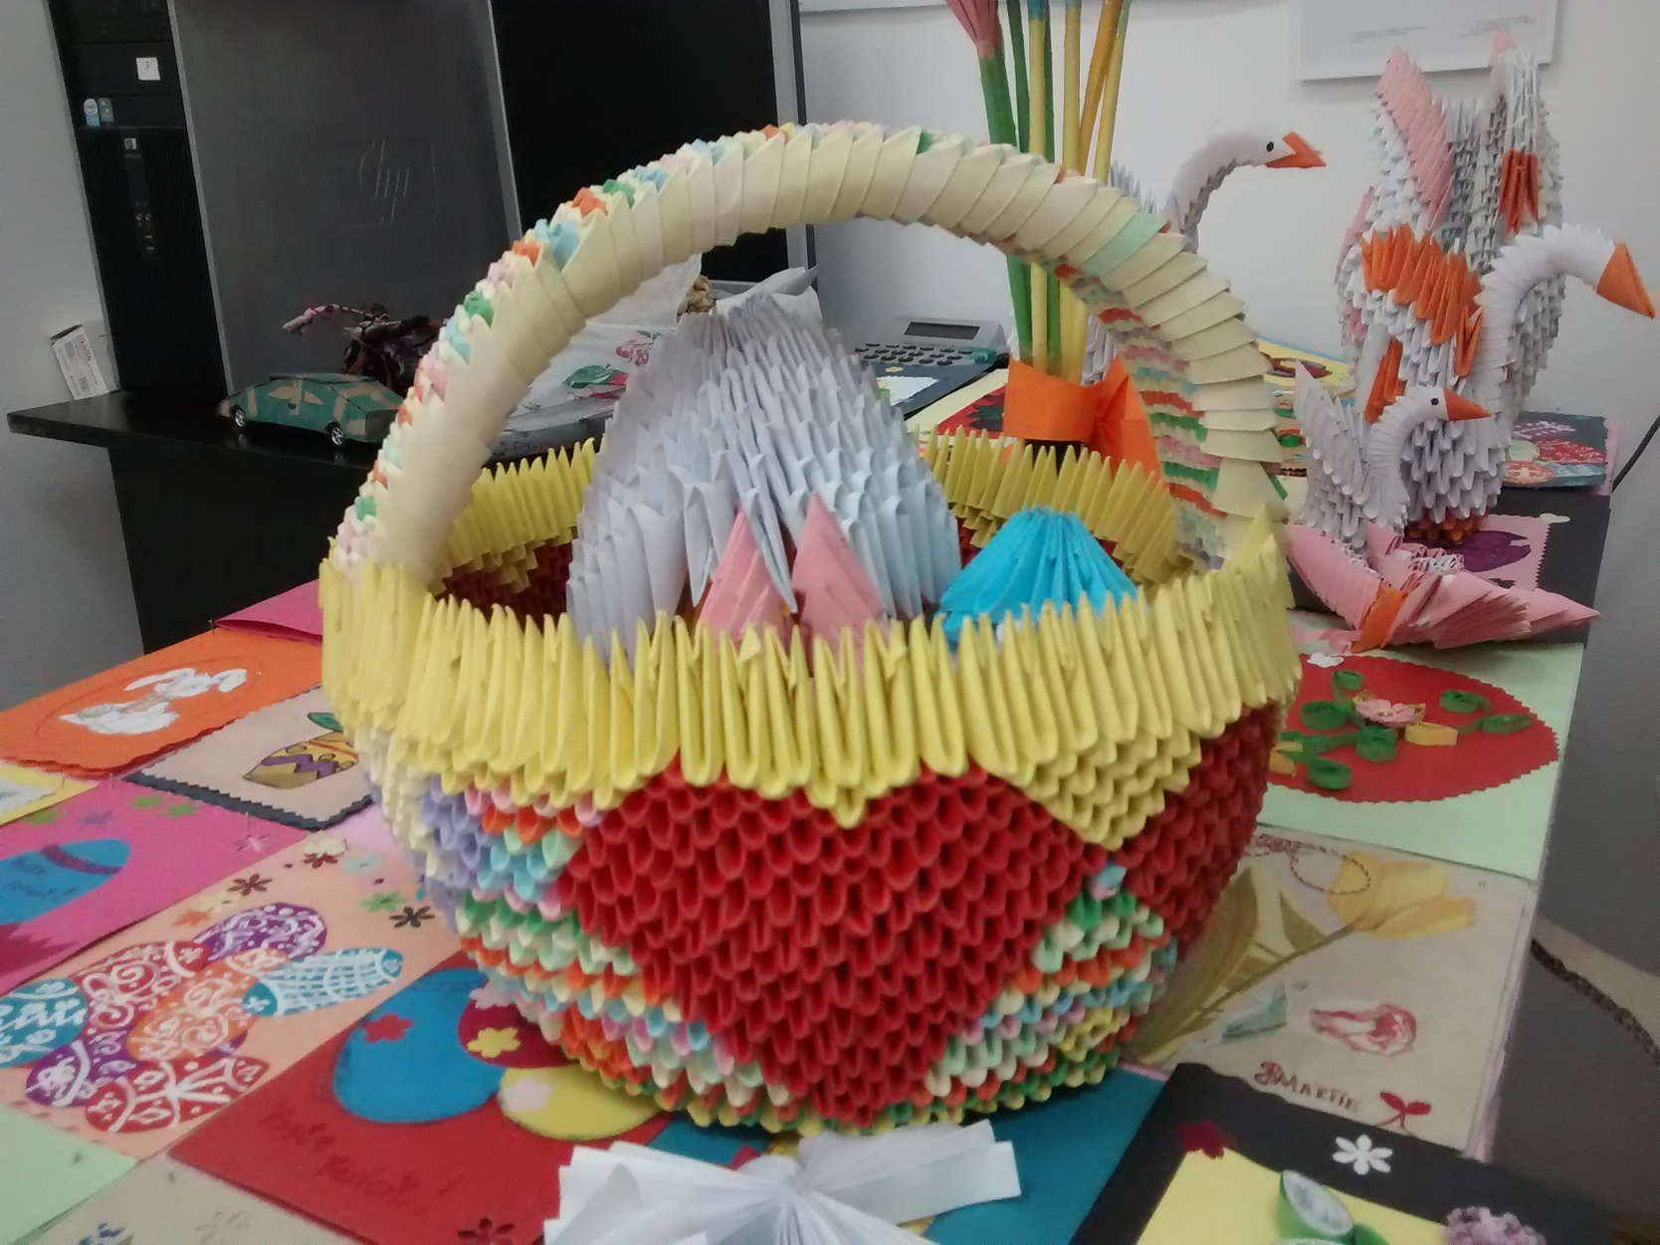

Slide 4
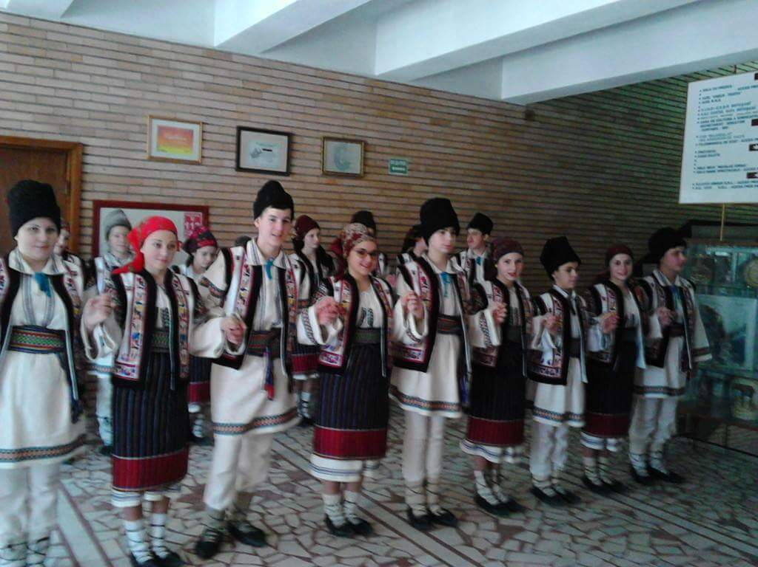
Our pupils wearing our traditional folk costume

Slide 5
European Day of Languages

Slide 6
Halloween Time

Slide 7
Christmas and New Year traditions

Slide 9
School Theatre Group

Slide 11
Some of our teachers

