Slide 1
Ukraine is my Motherland

Slide 2
Ukraine is one of the largest countries of Eastern Europe.

Slide 3
The capital of Ukraine is Kyiv.

Slide 4
Ukraine is an independent state and it has its own government

Slide 5
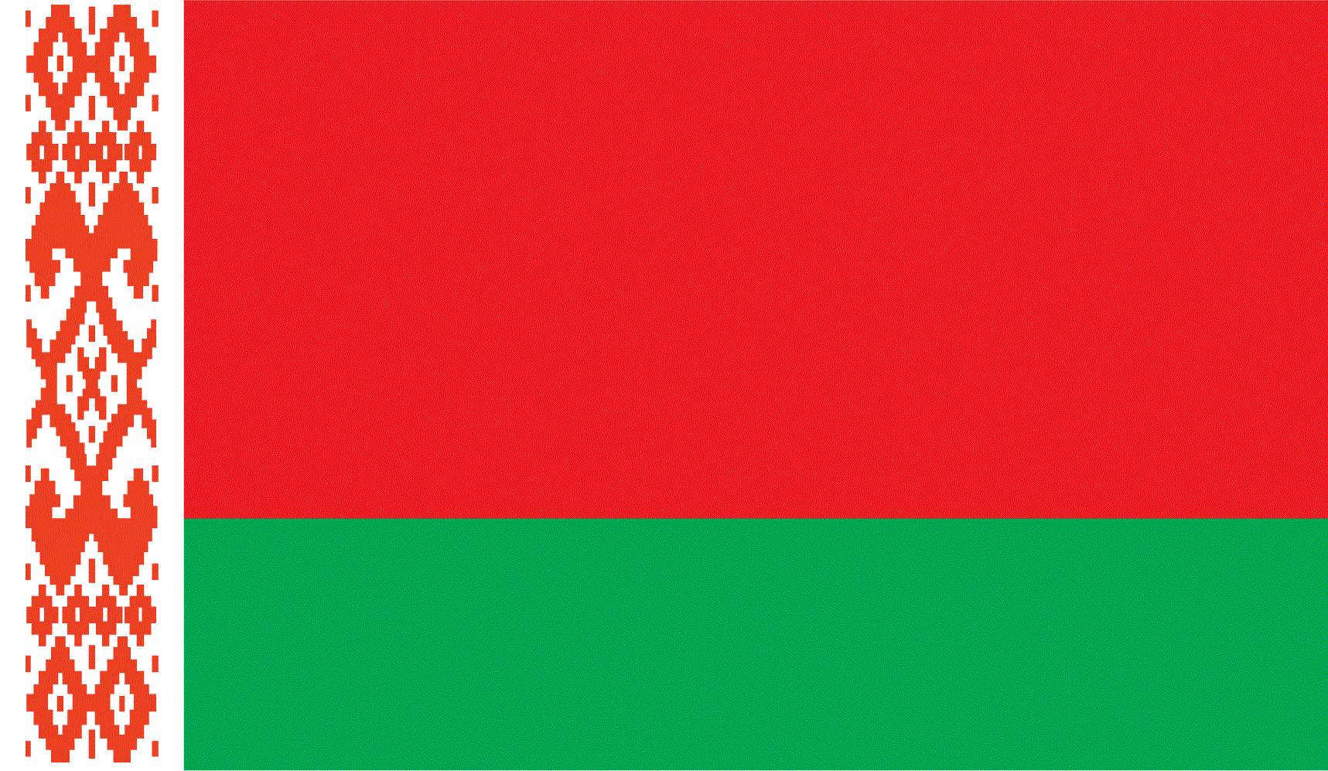
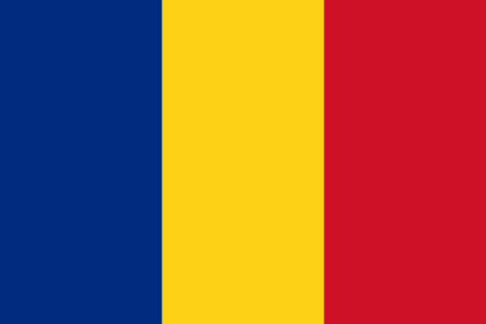
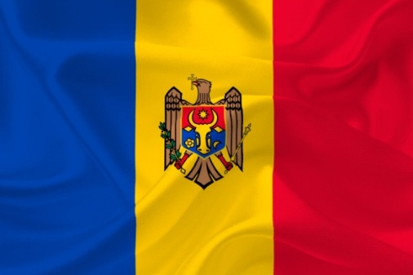
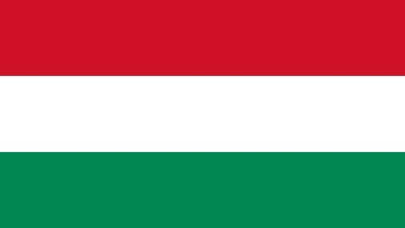
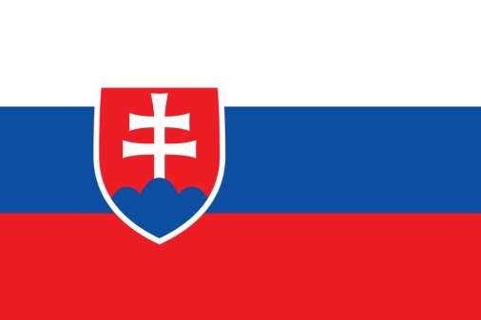
It has state borders with:
Russia
Belarus
Poland
Hungary
Romania
Moldova
Czech Republic

Slide 6
The population of Ukraine is about 47 million people.

Slide 7
People who live in Ukraine are Ukrainians. They all speak Ukrainian, the official language of the country.

Slide 8
The national currency in Ukraine is hryvnia

Slide 9
The biggest cities are:
Kyiv
Lviv
Odessa
Kharkiv
Dnipropetrovsk
Zaporizhia

Slide 10
Kyiv

Slide 11
Lviv

Slide 12
Odessa

Slide 13
Kharkiv

Slide 14
Dnipropetrovsk

Slide 15
Zaporizhia

Slide 16
There are a lot of places to see in Ukraine and to be proud of.

Slide 17
There are the Carpathians with their legends, castles, cathedrals and unique traditions

Slide 18
Ukrainians also have their own national clothes which are different in many parts of Ukraine and very beautiful indeed.

Slide 19
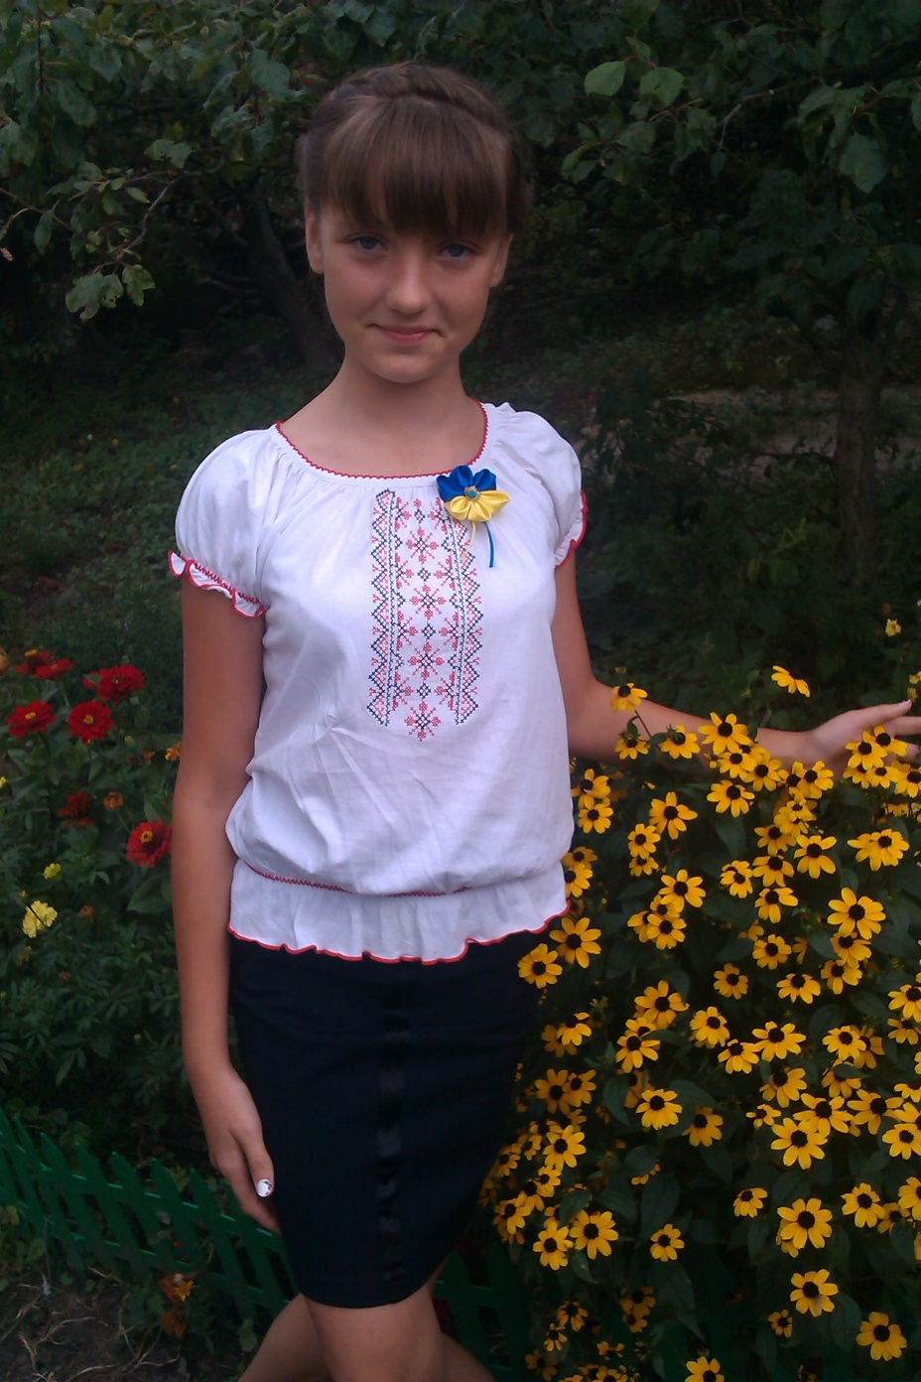
My Motherland, Ukraine, I love you!

