Slide 1
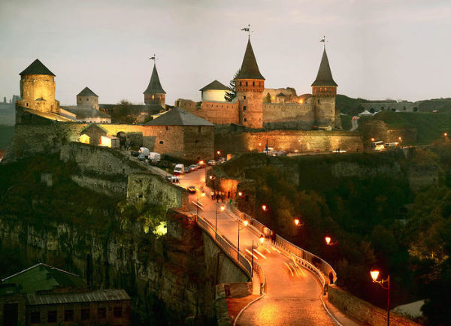
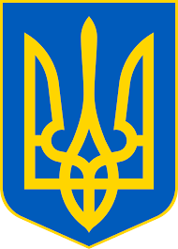
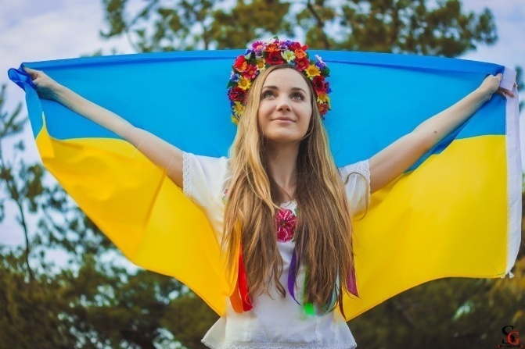
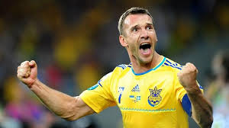
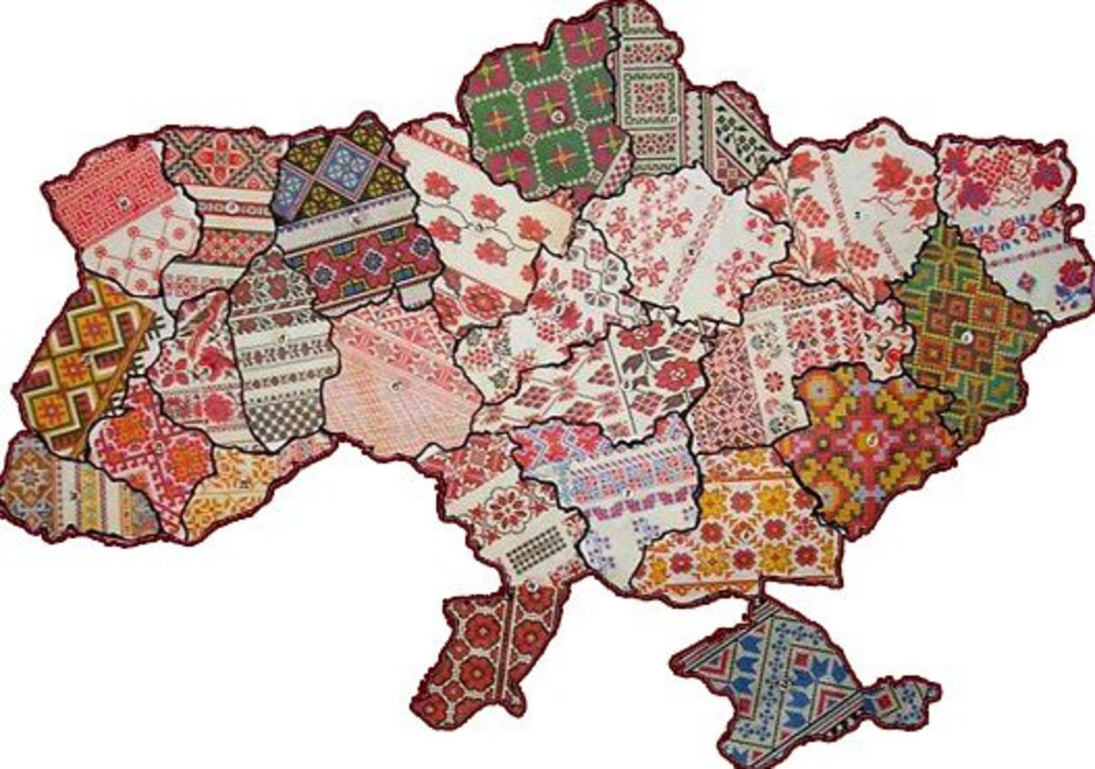
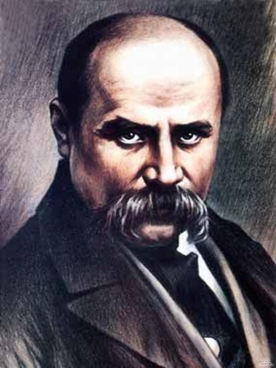
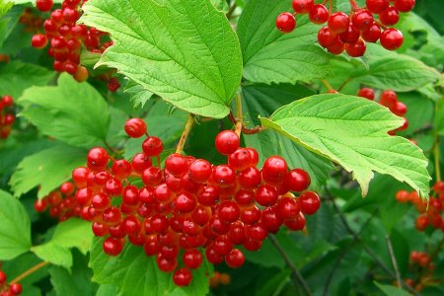
Ukraine

Slide 2
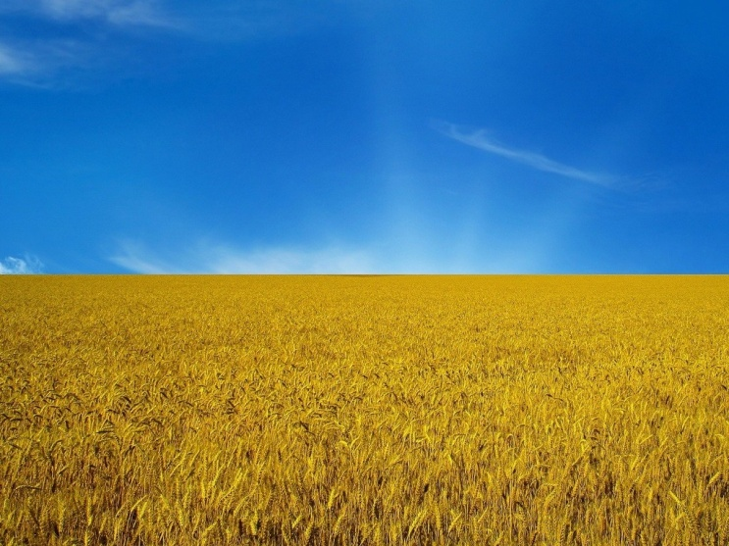
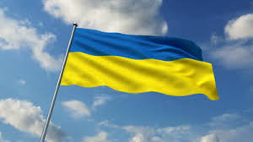
Ukrainian symbols
Our flag is blue and yellow. Blue represents the sky and yellow stands for the golden fields of wheat.
The emblem is the Golden Trident.
And the anthem is “Ukraine is still alive”.

Slide 3
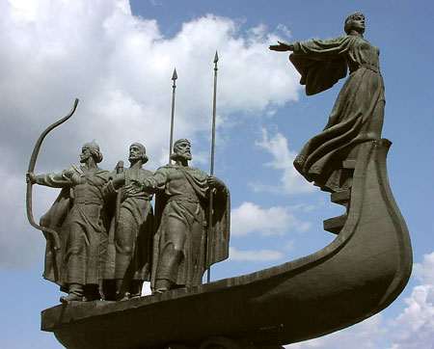
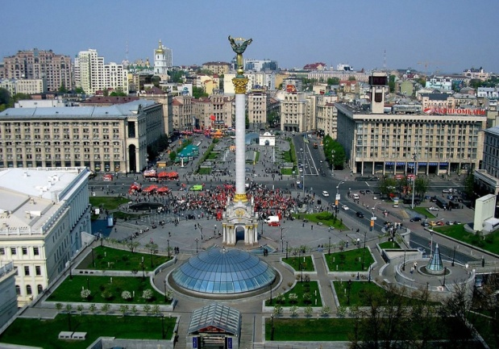
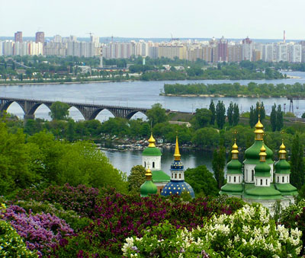
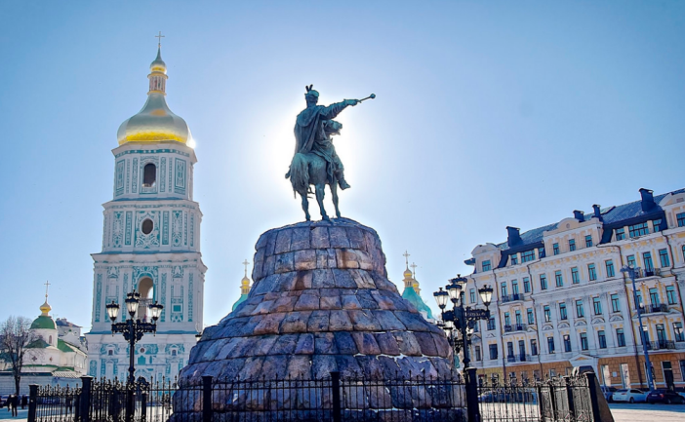
Kyiv – is the capital city.
It was founded by three brothers Kyi, Schek, Horyv and their sister Lybid in the 5th century.
Today it is one of the most beautiful cities in Europe. Nearly 3 mln people live there.

Slide 4
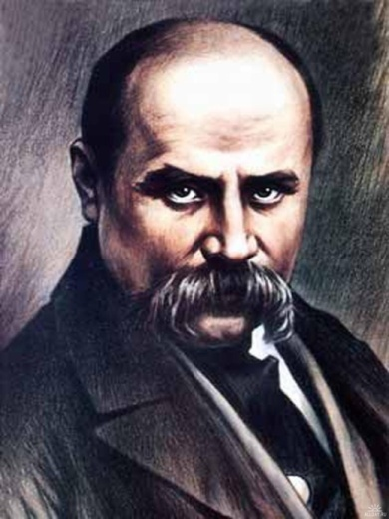
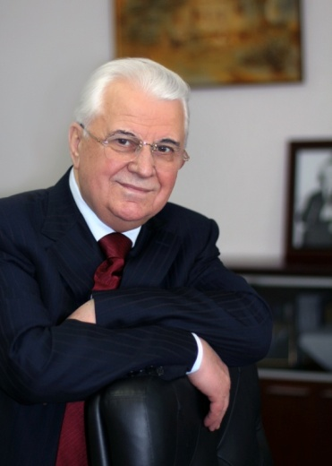
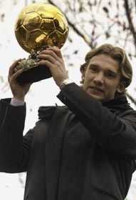
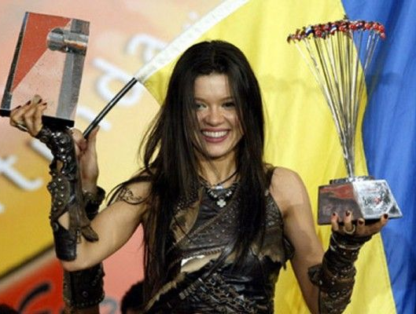
The most famous Ukrainians
Taras Shevchenko – a poet and painter.
Leonid Kravchuk – the 1st president of independent Ukraine.
Andriy Shevchenko – a great footballer, the winner of the Golden Ball in 2004.
Ruslana – the winner of Eurovision in 2004.

Slide 5
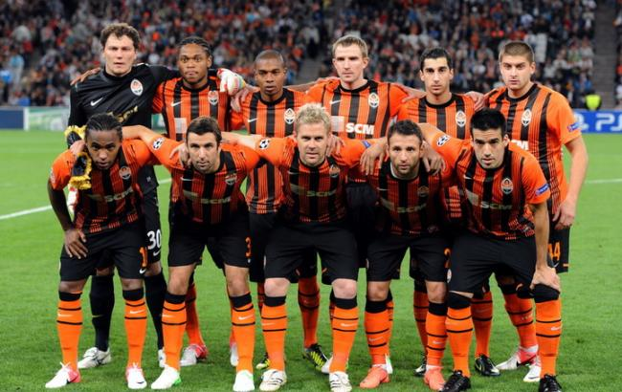
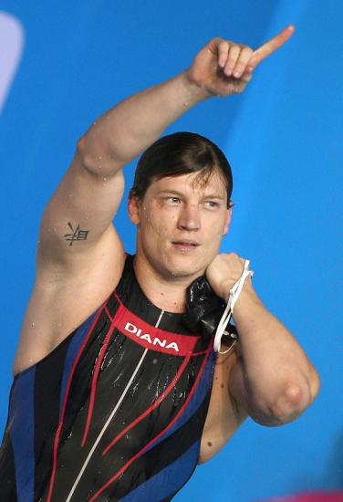
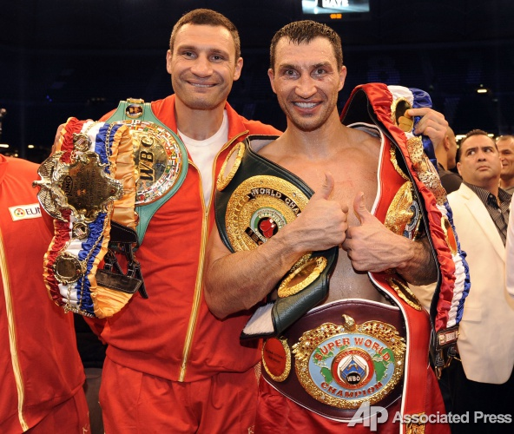
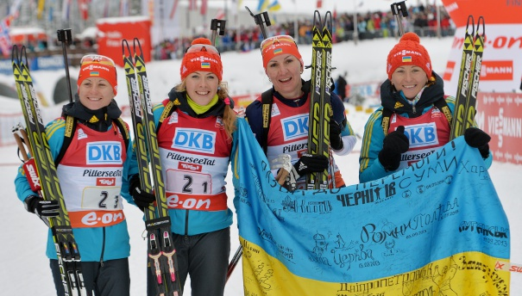
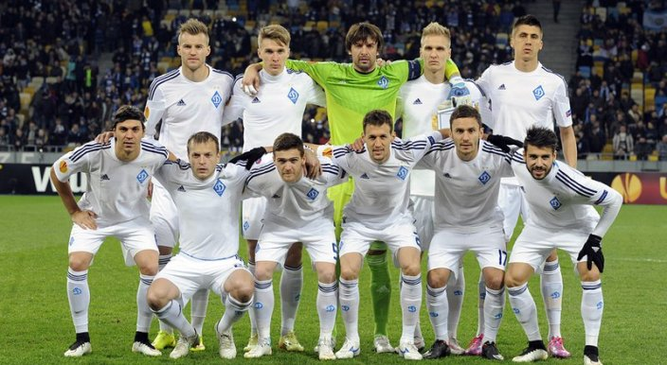
Popular sports
Shakhtar and Dynamo are the most famous football teams.
Swimming is represented by the world and Olympic champions Yana Klochkova, Oleh Lisohor.
Biathlon is a popular winter sport.
Ukrainian boxers Klychko brothers are known all over the world.

Slide 6
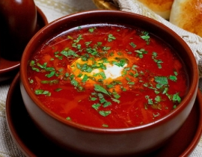
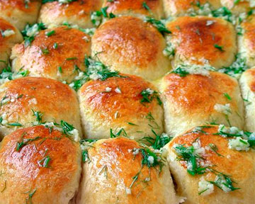
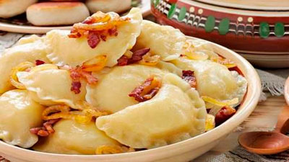
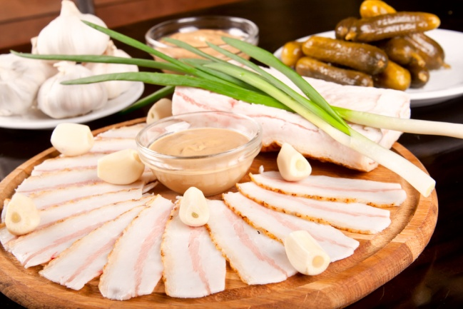
The traditional Ukrainian food
Borsch – a red beetroot soup.
Pampushkas – small buns with garlic.
Varenyks – dumplings with potatoes, cabbage, mushrooms.
Salo – salty raw bacon.

Slide 7
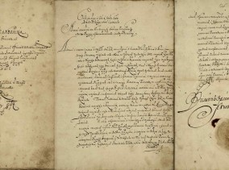
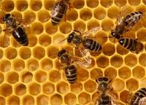
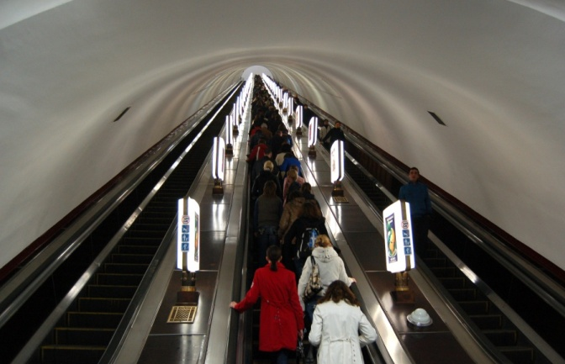
Interesting facts
The 1st constitution in the world was written by Pylyp Orlyk in 1710.
Ukraine is the greatest producer of honey in the world.
The deepest metro station in the world is Arsenalna in Kyiv – 105 m deep.

Slide 8
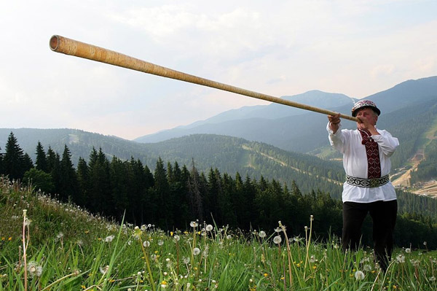
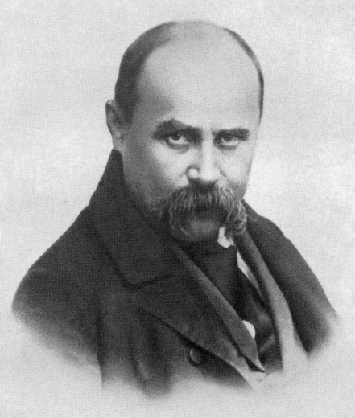
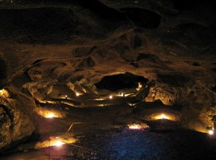
Interesting facts
Trembita – is the longest musical instrument.
1384 monuments to Ukrainian poet Taras Shevchenko, the most numerous in the world.
Cave Optimistic in western Ukraine is 20 m deep and 216 km long. It is the 1st longest in Europe, the 2nd in the world.

Slide 9
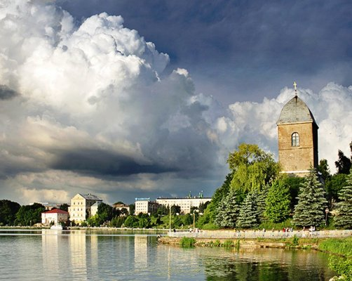
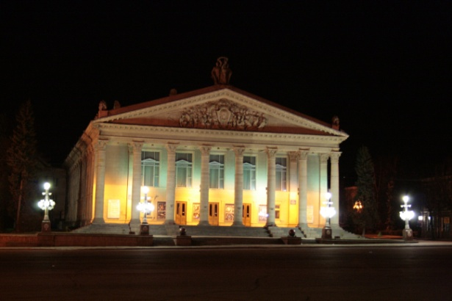
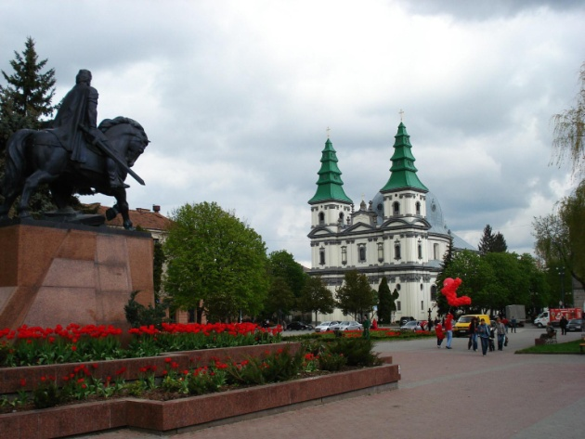
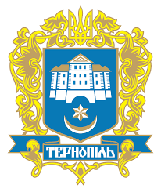
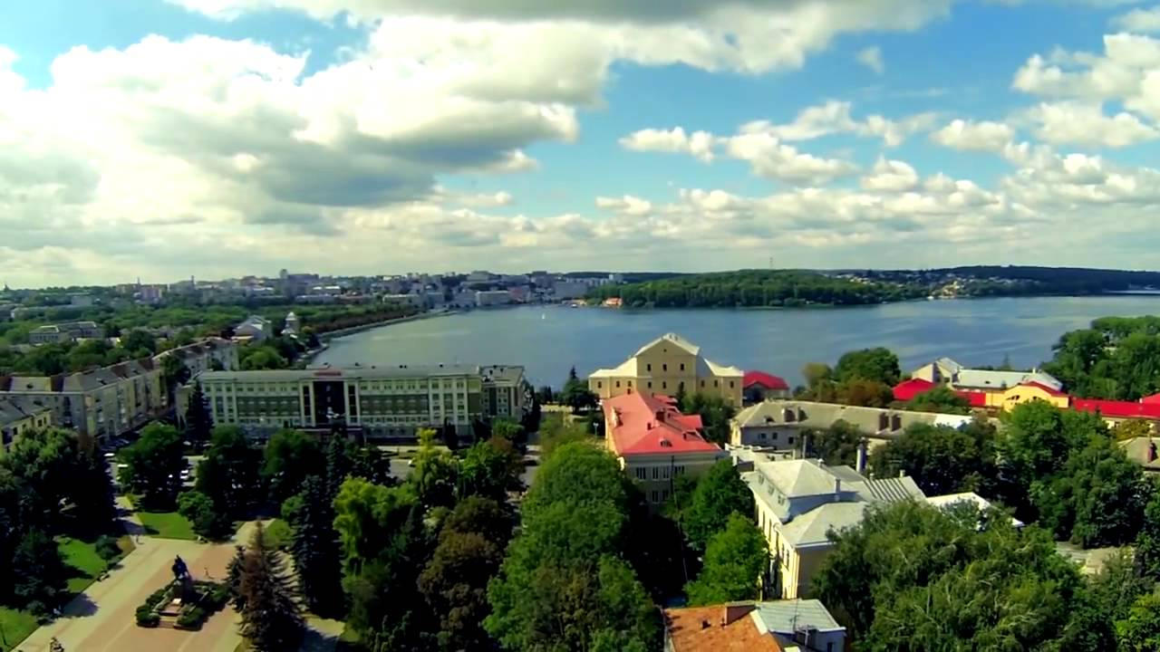
Our hometown - Ternopil
Ternopil is considered one of the most beautiful cities of Ukraine.
Founded in 1540 it is situated on the banks of the River Seret and Ternopil Lake.
The population is more than 200 000 people.

Slide 10
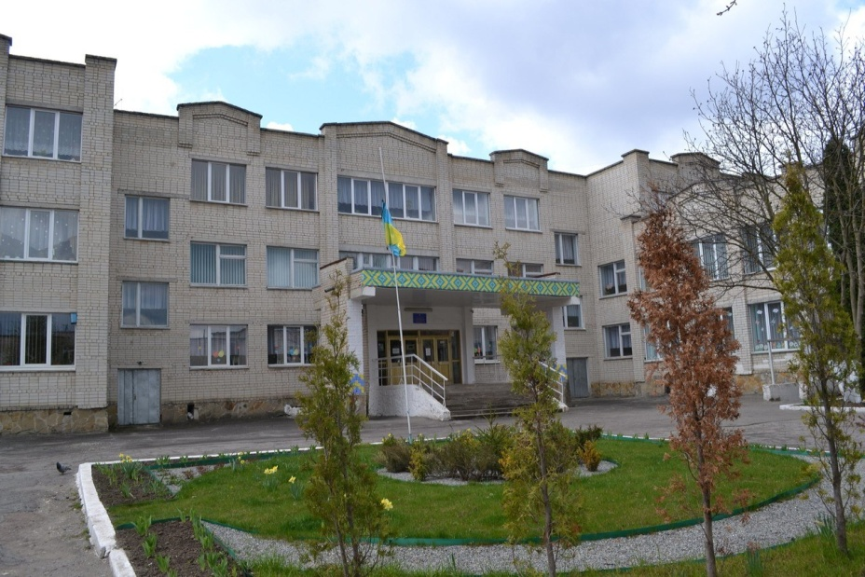
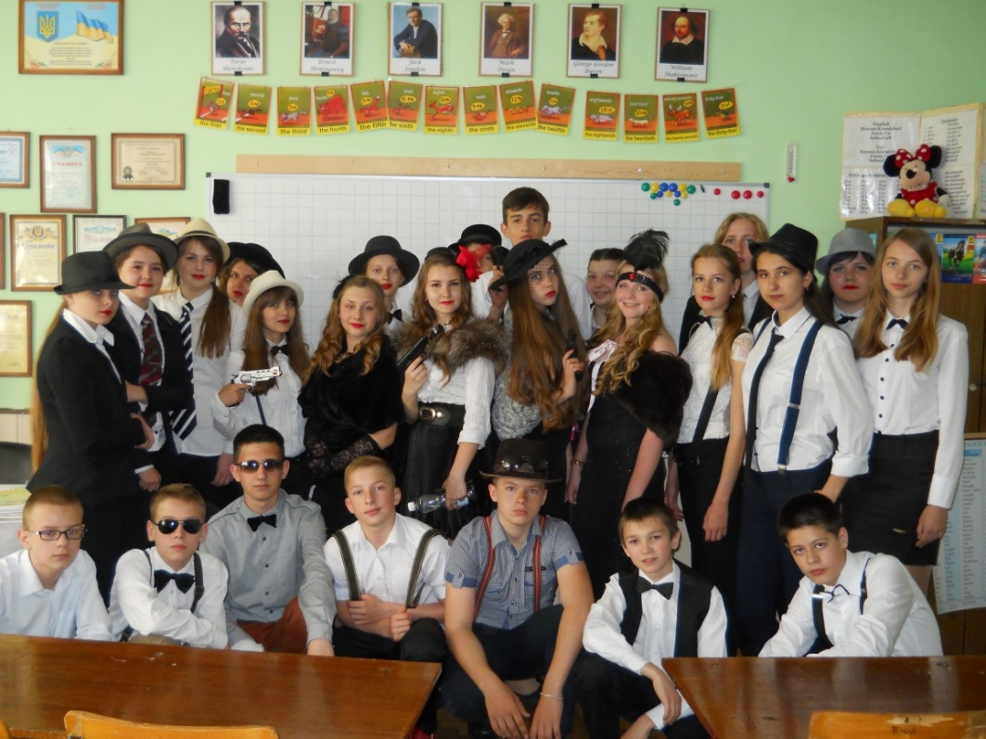
Best Wishes, from 9-B class, School 29, Ternopil Ukraine

